Slide 1
Traffic Assignment
Rob Fitzgerald
CSCI 7551 Research Presentation
Thursday, November 10th, 2016
Presentation originally titled “Maximization of Network Throughput Maintaining Free Flow”
All images and definitions due to [ORTUZAR] unless listed otherwise.

Slide 2
Question
How can we accurately assign drivers to routes on a transportation network in a way which is optimal for some system-wide equilibrium?

Slide 3
Contents
What is Traffic Assignment?
Traffic Assignment in detail
Overview
Wardrop Equilibria
Cost Functions
Stochastic Effects
Frank-Wolfe Algorithm
Project Implementation
Future Work
References

Slide 4
What is Traffic Assignment?

Slide 5
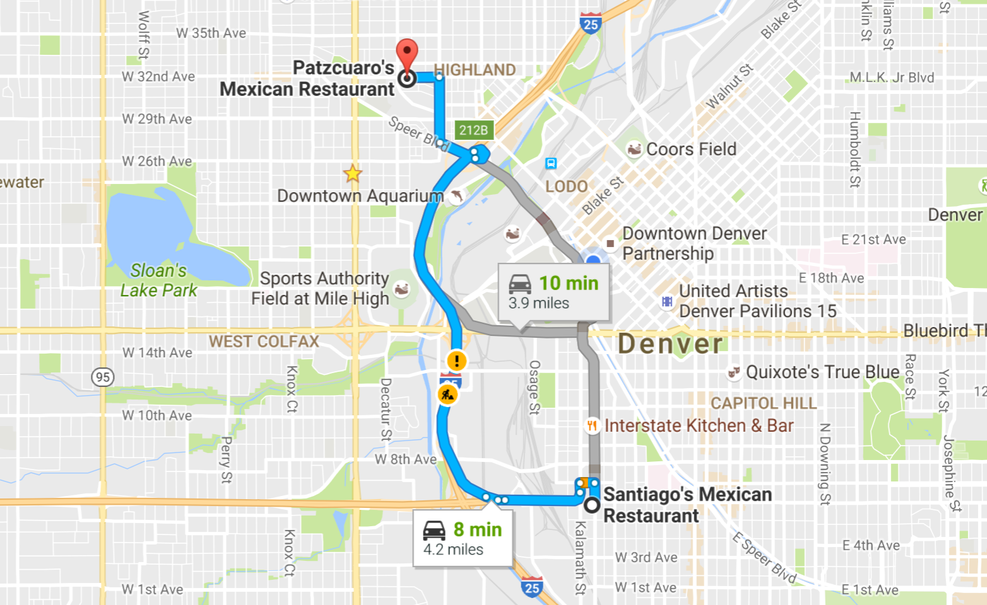
Typical driver routing is concerned with moving the driver from origin to destination at the least cost route for the driver - a greedy routing algorithm.
[GOOGLE]

Slide 6
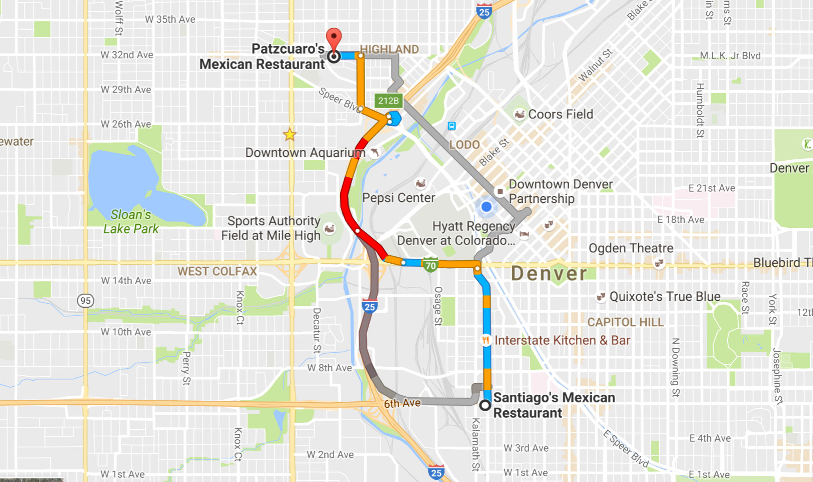
Aggregate behavior of greedy-based routing contributes to congestion as similar routes are applied without consideration of their buildup.
[GOOGLE]

Slide 7
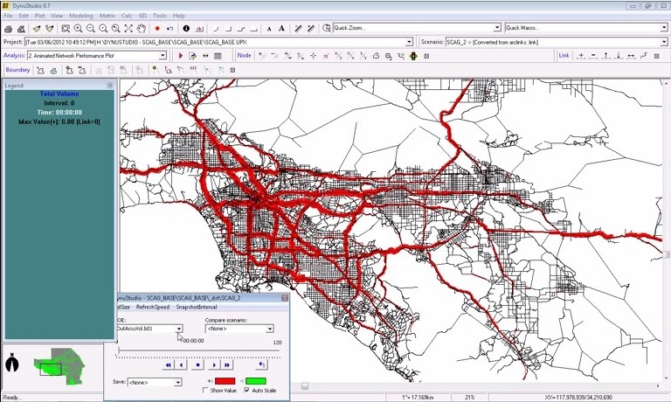
Methods to overcome these congestion-prone techniques fly under the banner of System Optimum Dynamic Traffic Assignment (SO-DTA)
[METROPIA]

Slide 8
Static Traffic Assignment
DTA developed from earlier techniques used to produce static models. My project will be an exploration of the static models.
Traffic Assignment is a synthesis of Graph Theory, Game Theory, and Linear Programming.
Its use is typically to model the impact of changes to the transportation network itself.

Slide 9
Traffic Assignment in Detail

Slide 10
Intuition
We need a method to formalize how we relate the impact of different routing choices to each other
We need algorithms which can apply that formalized method to a matrix of origin-destination (OD) pairs and an arbitrary road network
OD pairs in static Traffic Assignment usually refer to a vehicle-per-hour load, not an individual trip

Slide 11
Graph Theory
Tree-building methods for shortest paths spanning trees
Edge weights used to represent various roadway properties, used in Cost-flow calculations:
free-flow speed
capacity
flow

Slide 12
Game Theory
Multiple player games
Finding an optimum traffic assignment requires converging to an equilibrium
A framework to say "no other way of assigning traffic would result in improvement to the equilibrium"

Slide 13
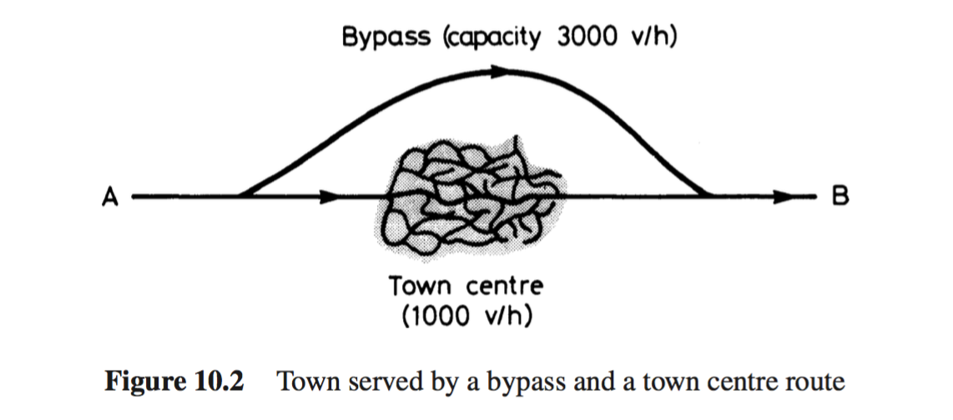
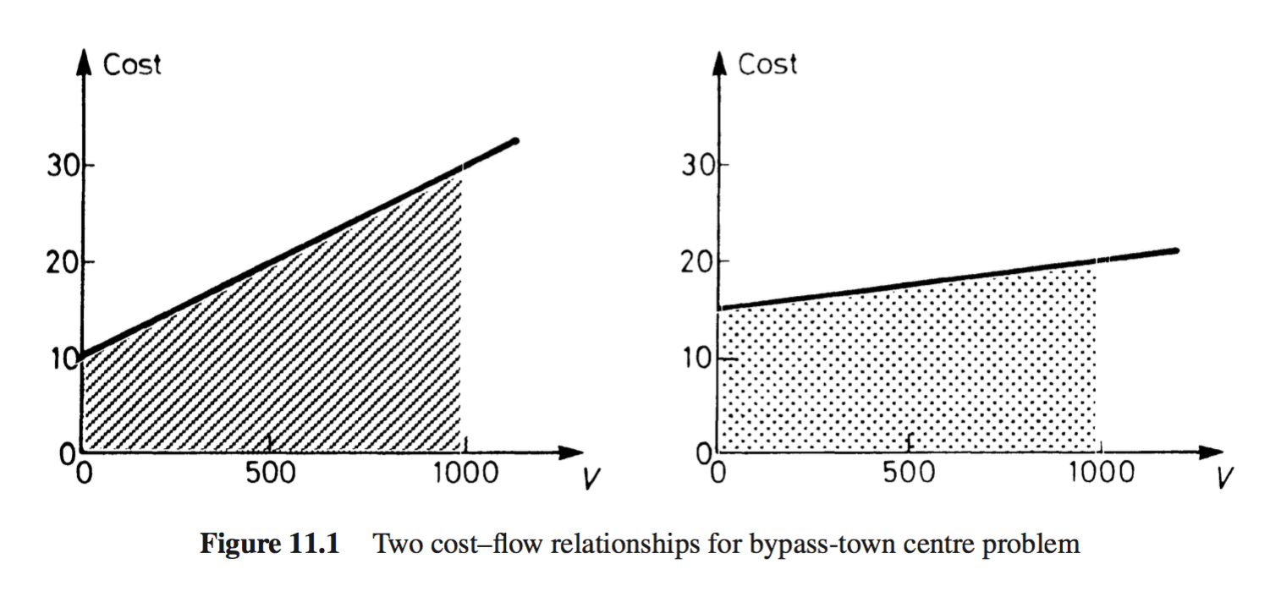
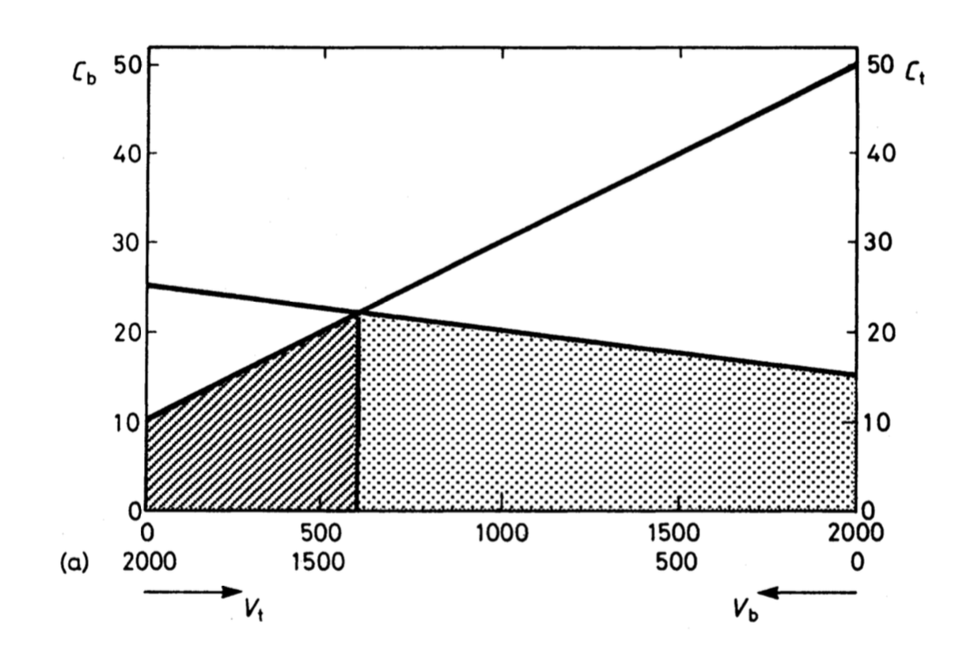
Equilibrium: a state in which opposing forces or influences are balanced.
Images: [ORTUZAR]
Equilibrium definition: [GOOGLE2]

Slide 14
Wardrop Equilibria
Introduced in 1952 by John Wardrop

Slide 15
Wardrop - Introduction
User Equilibrium (UE)
no traveler can improve their travel time by unilaterally changing routes.
System Optimum (SO)
average trip cost is minimized across all travelers. (travelers may be able to improve their travel time by changing routes)
Stochastic User Equilibrium (SUE)
no traveler believes that they can improve their travel time by unilaterally changing routes.
definitions: [SHEFFI]

Slide 16
First Principle: User Equilibrium
"Under equilibrium conditions traffic arranges itself in congested networks such that all used routes between an O–D pair have equal and minimum costs while all unused routes have greater or equal costs.”
Attempts to model the behavior of individual drivers as they try to minimize their own trip costs

Slide 17
Second Principle: System Optimum
"Under social equilibrium conditions traffic should be arranged in congested networks in such a way that the average (or total) travel cost is minimized.”
Presented as a design principle for transport planners

Slide 18
The resulting network flows from optimizing via UE or SO will differ.

Slide 19
Cost Functions
We will define static Traffic Assignment cost-flow functions C(Va) with parameters for edge capacity Qs, speed t0 (at free flow, aka no “resistance”) for the assigned traffic flow Va.
Many cost-flow functions have been proposed for static assignment.
These carry the assumption that we are modeling steady-state conditions.

Slide 20
Cost Function Properties
Should produce realistic results
Continuous, differentiable, non-decreasing, and monotonic
Should allow the existence of an overflow region which is computable

Slide 21
t = t0 exp(V/Qs)
Va: Flow in vehicles per unit time
C(Va): Cost-Flow Function
Qs: Steady-state link capacity
t0: Free-flow link travel time
t: Travel-time per unit distance
α, ß: calibration parameters
Smock (1962): Detroit Transportation Study
using t0 = 25mph, Q=200

Slide 22
Va: Flow in vehicles per unit time
C(Va): Cost-Flow Function
Qs: Steady-state link capacity
t0: Free-flow link travel time
t: Travel-time per unit distance
α, ß: calibration parameters
Overgaard (1967)
t = t0α^{ß(V/Q)}
using t0 = 25mph, Q=200, α=0.15, ß=4

Slide 23
Va: Flow in vehicles per unit time
C(Va): Cost-Flow Function
Qs: Steady-state link capacity
t0: Free-flow link travel time
t: Travel-time per unit distance
α, ß: calibration parameters
Bureau of Public Lands (1964)
t = t0 [1 + α(V/Q)^{ß}]
using t0 = 25mph, Q=200, α=0.15, ß=4

Slide 24
Stochastic Methods
"Having a random probability distribution or pattern that may be analysed statistically but may not be predicted precisely.”
Monte Carlo: uses calculated engineering costs as the mean of a distribution for edge weights
Proportional Method: creates a proportional distribution of routes
definition: [OXFORD]

Slide 25
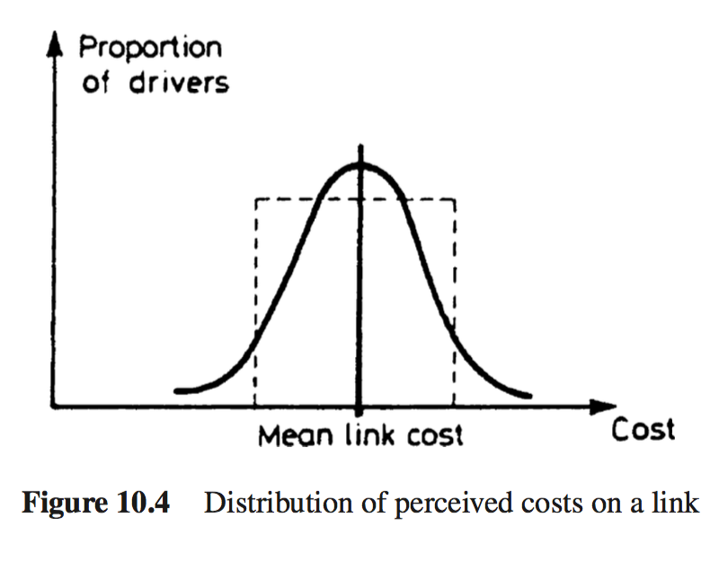
Monte Carlo Simulation
Compute Perceived costs for each link by sampling from the corresponding distributions of costs by means of random numbers
Build the minimum perceived cost path from i to j and assign a portion of ij drivers to the current “shortest path”

Slide 26
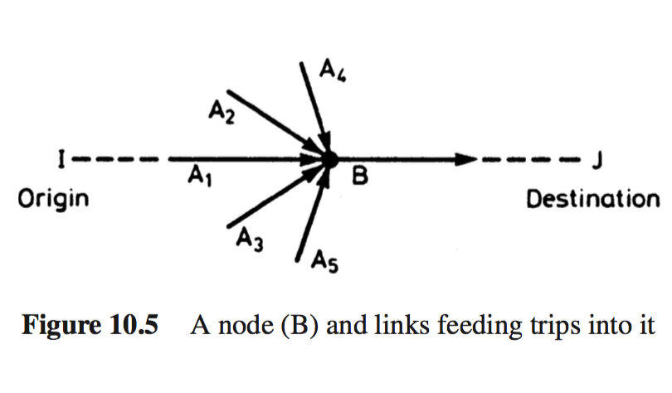
Proportional Method
For a given intersection, test the shortest path distance from the origin to the intersection on each of its inflows, and proportionally divide drivers with weight given to shorter paths to the inflows

Slide 27
Stochastic Methods
Stochastic techniques are designed to help us better model user preferences and irrational behavior
Many Dynamic Traffic Assignment methods rely on Stochastic User Equilibrium
Both methods do not guarantee convergence

Slide 28
Frank-Wolfe Algorithm
Iterative Linear Approximation Algorithm which uses gradient descent to find an optimal traffic assignment
A general optimization technique
Converges to Wardrop’s equilibrium

Slide 29
Frank-Wolfe Algorithm
Is a method of successive averages, recursive and with the all-or-nothing assignment as its upper bound
In each iteration, it produces a new flow on each link which is a function of the previous flow and the all-or-nothing flow (the flow assigned without consideration of congestion effects)

Slide 30
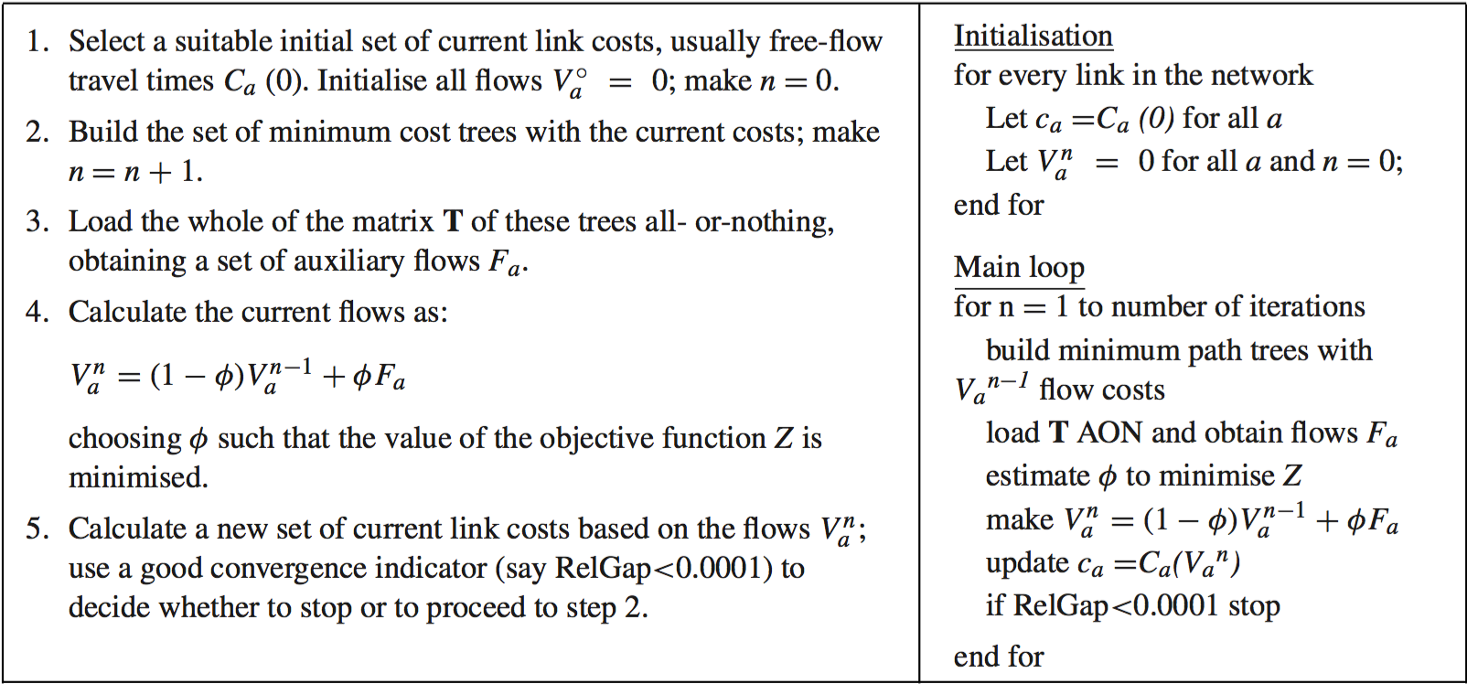
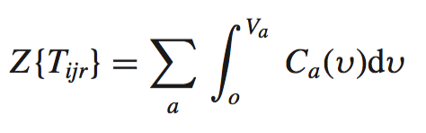
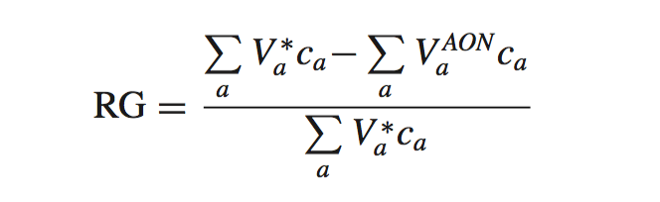
Frank-Wolfe Algorithm
Relative Gap: RG()
Objective: Z()
Tijr is the set of path flows which satisfy UE
Va^{AON} is the all-or-nothing assignment of Va
[ORTUZAR]

Slide 31
Project Implementation
C++ Simulation with parallelized Frank Wolfe algorithm
User-selectable cost function
Reads road network and trip matrix from file input

Slide 32
Parallelized Frank-Wolfe
Parallel shortest path tree generation: creates a tree for each OD pair, using a label-correcting method, on each iteration
Parallel edge weight modification in the Frank-Wolfe iterations for each OD pair flow, which modifies the shared, base transportation graph

Slide 33
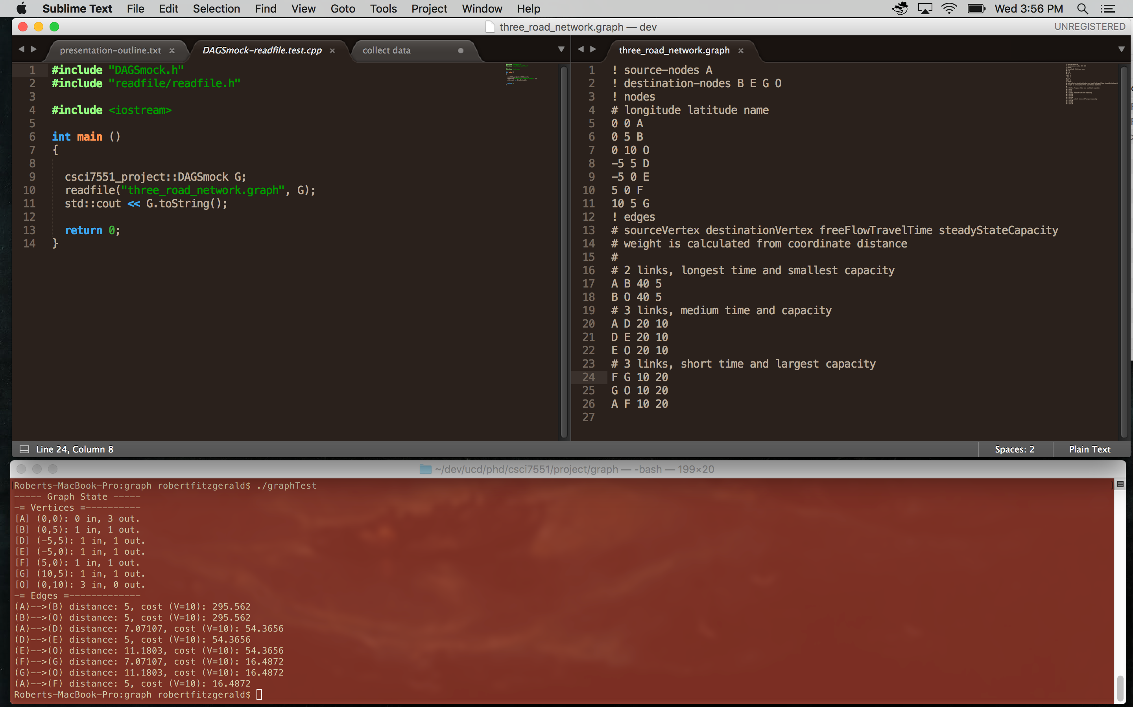
Simple road network test

Slide 34
Future Work
Stochastic techniques for cost functions in traffic assignment
Distributed Frank-Wolfe [WANG]

Slide 35
References
[ORTUZAR] Juan de Dios Ortuzar, Luis G. Willumsen, “Assignment” in Modelling Transport, 4th Ed. New York: Wiley, 2011, pp. 349-390.
[SHEFFI] Sheffi, Yoshi, Urban Transportation Networks: Equilibrium Analysis with Mathematical Programming Methods, Prentice Hall,1985.
[GOOGLE] maps.google.com
[GOOGLE2] https://www.google.com/search?q=equilibrium
[METROPIA] http://www.metropia.com/tags/dynamic-traffic-assignment-dta
[OXFORD] https://en.oxforddictionaries.com/definition/stochastic
[WANG] Yu-Xiang Wang et. al., Parallel and Distributed Block-Coordinate Frank-Wolfe Algorithms, Proceedings of The 33rd International Conference on Machine Learning, pp. 1548–1557, 2016.

